Slide 1
CAS-65986-P4P0 active UL users is much bigger then DL
Xu YangChun

Slide 2
Problem reported
On all TDD sites the number of UL active users is 5...30 times bigger then of DL. On FDD sites the number of active users in UL and DL is approximately equal.

Slide 3
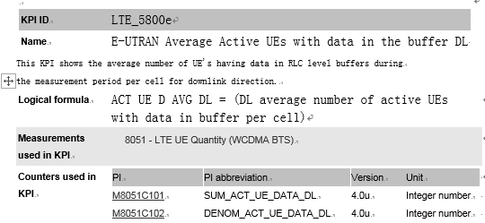
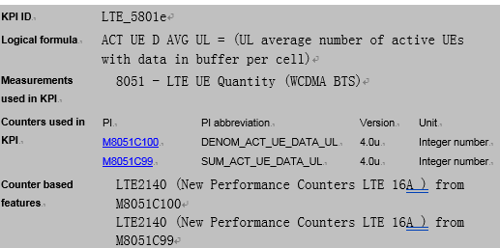
KPI related

Slide 4

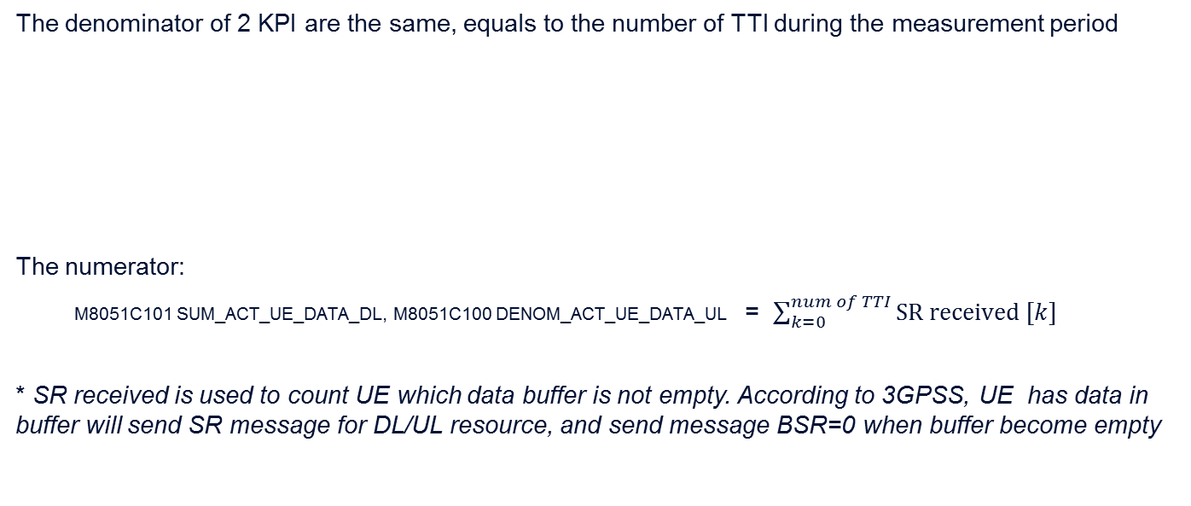
KPI analysis
The denominator of 2 KPI are the same, equals to the number of TTI during the measurement period
The numerator:
M8051C101 SUM_ACT_UE_DATA_DL, M8051C100 DENOM_ACT_UE_DATA_UL = $\sum_{k=0}^{num of TTI}{SR received [k]}$
* SR received is used to count UE which data buffer is not empty. According to 3GPSS, UE has data in buffer will send SR message for DL/UL resource, and send message BSR=0 when buffer become empty

Slide 5
Count analysis
for the value of SR received , it is designed as
+1 when a new SR received
-1 when a BSR=0 message received
In DL, the SR/BSR happened inside the eNB SW, no delay.
In UL, the BSR message itself need wait for scheduling in air interface.
If FDD, every TTI can carry UL data, the delay can be ignored too.
If TDD, e.g. in MTS config, only subframe 2,7 was UL, the minimum time for waiting BSR=0 message is 10 TTI, due to the PRB of SR is defined in vendor and it is small, so most of the BSR =0 message at least 20ms can be received in UL, in TTI prior to it, the SR received will be bigger than real situation. When there are many UE sending small packet, meaning sending BSR=0 frequently, the SR received will be much bigger.

Slide 6
UL/DL ratio
It depend on the traffic model
if both UL/DL traffic is full, the ratio shall be 1
But if the traffic is not full, the ratio can be many bigger, e.g. as the snapshot provided by MTS team show
(to continued).

Slide 7
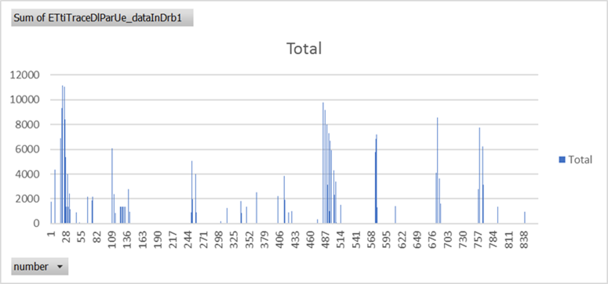
Snapshot analysis
In DL, most time there is no data in buffer, so the DL KPI is much smaller than the number of UE connected

Slide 8
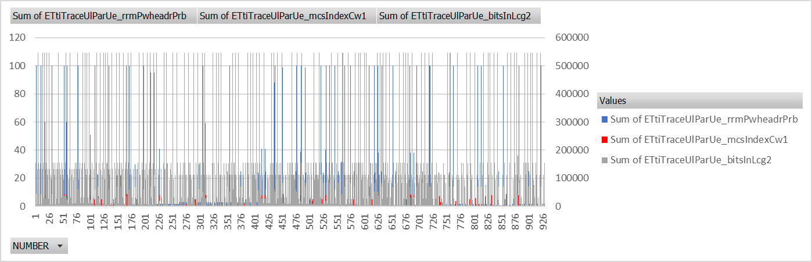
In UL, due to low MCS, and many UEs are power limited. the UL KPI is much bigger than the number of UE connected

Slide 9
Conclusion
Current design will bring deviation in TDD
UL/DL ratio depends mostly on the traffic model
As shown in snapshot, the UE is mostly distributed in cell edge, the network optimization is needed.

Slide 10
Logs
\\eseefsn50.emea.nsn-net.net\rotta4internal\LTE\zjalex\CAS-65986-P4P0 - active UL users is much bigger then DL

Slide 11


Slide 12
Copyright and confidentiality
The contents of this document are proprietary and confidential property of Nokia. This document is provided subject to confidentiality obligations of the applicable agreement(s).
This document is intended for use of Nokia’s customers and collaborators only for the purpose for which this document is submitted by Nokia. No part of this document may be reproduced or made available to the public or to any third party in any form or means without the prior written permission of Nokia. This document is to be used by properly trained professional personnel. Any use of the contents in this document is limited strictly to the use(s) specifically created in the applicable agreement(s) under which the document is submitted. The user of this document may voluntarily provide suggestions, comments or other feedback to Nokia in respect of the contents of this document ("Feedback"). Such Feedback may be used in Nokia products and related specifications or other documentation. Accordingly, if the user of this document gives Nokia Feedback on the contents of this document, Nokia may freely use, disclose, reproduce, license, distribute and otherwise commercialize the feedback in any Nokia product, technology, service, specification or other documentation.
Nokia operates a policy of ongoing development. Nokia reserves the right to make changes and improvements to any of the products and/or services described in this document or withdraw this document at any time without prior notice.
The contents of this document are provided "as is". Except as required by applicable law, no warranties of any kind, either express or implied, including, but not limited to, the implied warranties of merchantability and fitness for a particular purpose, are made in relation to the accuracy, reliability or contents of this document. NOKIA SHALL NOT BE RESPONSIBLE IN ANY EVENT FOR ERRORS IN THIS DOCUMENT or for any loss of data or income or any special, incidental, consequential, indirect or direct damages howsoever caused, that might arise from the use of this document or any contents of this document.
This document and the product(s) it describes are protected by copyright according to the applicable laws.
Nokia is a registered trademark of Nokia Corporation. Other product and company names mentioned herein may be trademarks or trade names of their respective owners.

